Slide 1
Comorbidity + ACF modelling

Slide 2
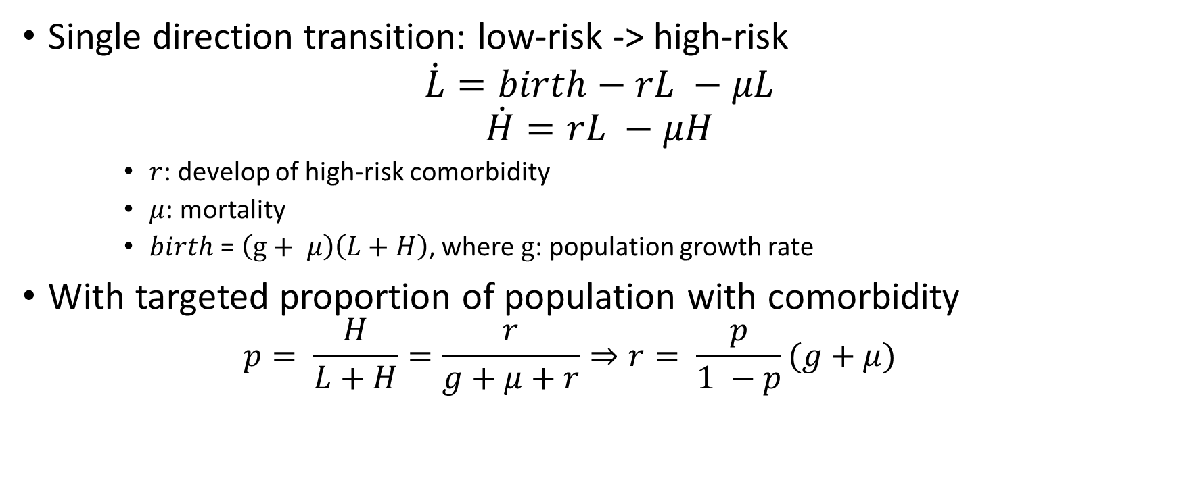
Development of comorbidity
Single direction transition: low-risk -> high-risk
$$\dot{L}=birth−rL −μL$$
$$\dot{H}=rL −μH$$
$r$: develop of high-risk comorbidity
$μ$: mortality
$birth$ = $\left(g+ μ\right)\left(L+H\right)$, where $g$: population growth rate
With targeted proportion of population with comorbidity
$$p= \frac{H}{L+H}=\frac{r}{g+μ+r}⇒r= \frac{p}{1 −p}(g+μ)$$

Slide 3
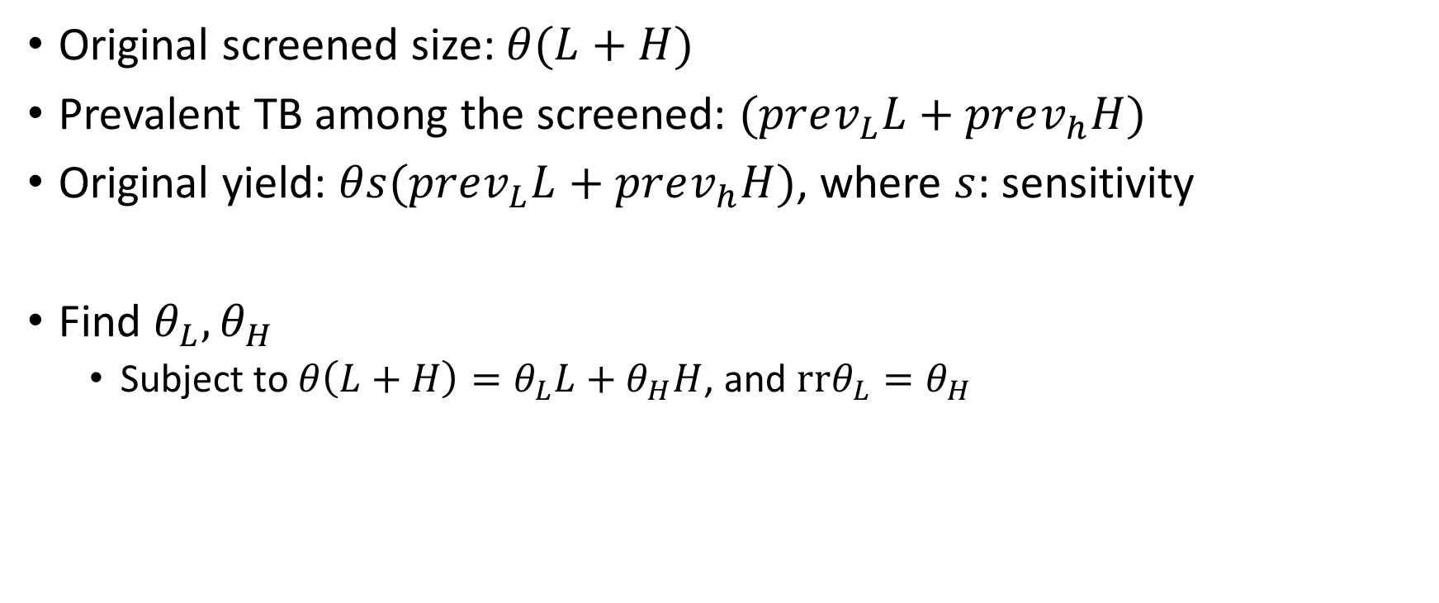
ACF by comorbidity
Original screened size: $θ(L+H)$
Prevalent TB among the screened: $(prev_{L}L+prev_{h}H)$
Original yield: $θs(prev_{L}L+prev_{h}H)$, where $s$: sensitivity
Find $θ_{L}, θ_{H}$
Subject to $θ\left(L+H\right)=θ_{L}L+θ_{H}H$, and $rrθ_{L}=θ_{H}$

Slide 4
Experiment settings
ACF scenarios: high sensitivity vs moderate sensitivity
Timespan: 2020-2023 linearly scaling-up, 2023-2030 continuation
ACF coverage (20%, 50%) vs 0% baseline
Comorbidity: relative TB risk, (1, 1.5) and relative rate of ACF (1, 2)

Slide 5
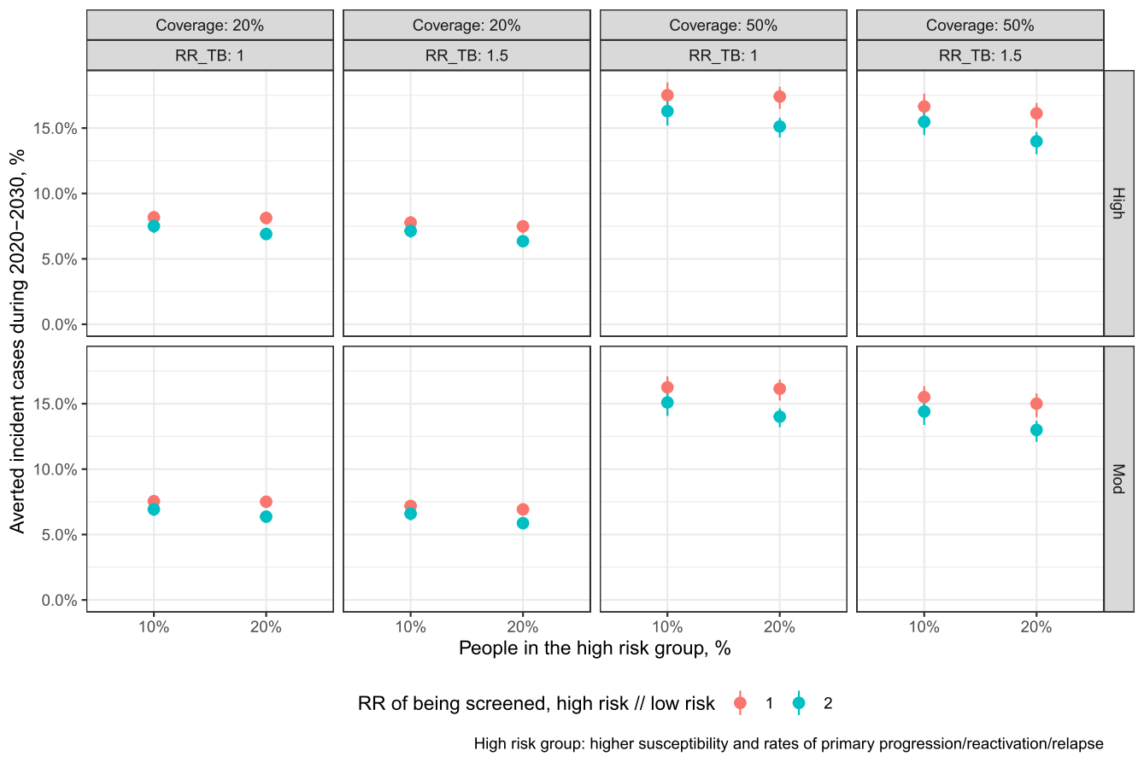
Preliminary results

Slide 6
Issues and possible fixes
The high-risk group have a higher LTBI % -> higher overall immunity to new infection.
Reversible comorbidity development process.
Higher risk to TB with calibration targets for % TB among high-risk group.
As the high-risk group have less prevalent TB, an ACF prioritising the group more will have less yields

